Slide 1
Impact Assessment of SPS Measures
Nile perch case study - Kenya
Meeting of Experts to Update EAC Harmonised SPS Measures and Procedures Documents
Kampala, 24 - 27 May 2010
Edewa, Obungu, Kleih

Slide 2
Analysis of impacts – core indicators
Economic – real income; employment; fixed capital formation;
Social – poverty; health and education; equity;
Environmental – environmental quality; biodiversity;
Process – consistency; institutional capacity.
  For details of secondary indicators see Methodology Presentation

Slide 3
Lake Victoria Fisheries – Value Chains
Localized trading along the lake shore and markets within the hinterland.
Local trade with urban areas
Inter-regional trade between Kenya, Uganda and Tanzania.
Extra-regional international exports.

Slide 4
Kenyan SPS System Dealing with Fisheries Notifications at the Time of the EU Bans to Import Nile Perch
Basic elements of a food safety control system were in place in the mid-1990s;
The national food safety system in Kenya was managed by various agencies under different ministries and laws
Legislation was out-dated and not compatible with international standards

Slide 5
Timeline of the bans
Dates ban imposed | Dates ban lifted | Restrictions | Products/ Regions
27 Nov 1996 | 3 April 1997 | Exports prohibited to Spain and Italy due to salmonella | Nile perch
4 April 1997 | 30 June 1998 | Border testing of all consignments for Salmonella | Nile perch
23 Dec 1997 | 30 June 1998 | Exports prohibited to the EU | Fresh fish
 |  | Border testing of all consignments for Vibrio cholerae and Vibrio parahaemoliticus | Frozen/ processed fish not caught at sea and directly landed to EU
25 Mar 1999 | 1 Dec 2000 | Exports prohibited to EU due to alleged use of pesticides | Fish from Lake Victoria

Slide 6
Institutional changes due to the bans
The formation of the Association of Fish Processors and Exporters of Kenya (AFIPEK)
Reorganization of administrative responsibilities within government for the regulation of the fish sector
Establishment of a Competent Authority

Slide 7
Initial outcomes of the bans
Lost export revenues
Changes in trade flows
Changes in relative prices

Slide 8
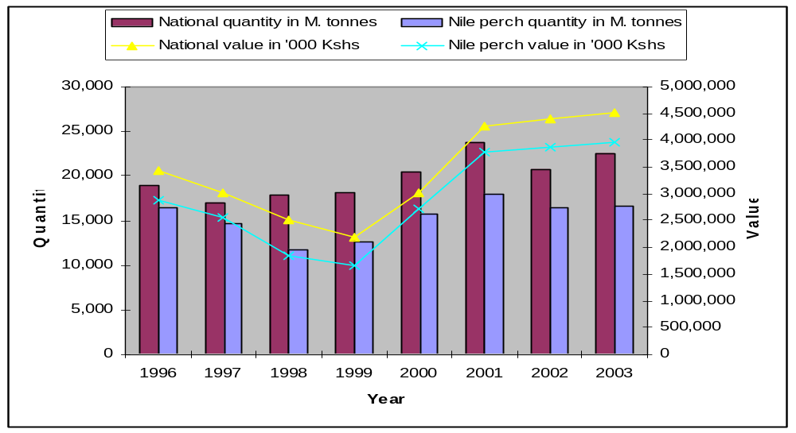
Kenyan Fish Exports
1996 - 2003

Slide 9
Changes at Production, Processing, and Marketing levels
Establishment of BMUs at landing sites
Fish processors adopted Good Hygiene Practices (GHP), and a complete Food Safety Management system based on Hazard Analysis and Critical Control Points (HACCP)
Changes in export marketing system (e.g. block frozen fillets)
Changes in domestic marketing system (e.g. increased demand in urban centres; lower landed prices of fish)

Slide 10
Economic impacts
Reduced earnings in local fishing communities
Other businesses in the communities were also affected
The need to use competent staff led to replacement of many temporary workers with few qualified ones in the processing factories

Slide 11
Social impacts
BMUs provide a social framework on which quality, safety, legal and emerging issues can be addressed
Training in food safety – also impacting on domestic value chain
The Association of Fish Processors and Exporters Association of Kenya (AFIPEK) was established

Slide 12
Environmental impacts
Reduced Nile Perch catches during the ban
Increased catches afterwards to the point of declining stocks
Establishment of BMUs, which have stock management and other functions

Slide 13
Institutional impacts due to the bans
The formation of the Association of Fish Processors and Exporters of Kenya (AFIPEK)
Reorganization of administrative responsibilities within government for the regulation of the fish sector
Establishment of a Competent Authority

Slide 14
Flanking measures - Examples
Economic measures – fisherfolk and landing beaches; processing factories, e.g. in 2000 AFIPEK published a Code of Good Manufacturing Practice for the Handling and Processing of Fish and Fishery Products in Kenya with funding from UNIDO.
Social measures - Through the BMUs, awareness raising and training were conducted on food safety practices and other issues

Slide 15
Flanking measures – examples, ctd.
Environmental measures - Lake Victoria Environmental Management Program
BMUs - Promotion of organizations of fisher-folk to, amongst other things, monitor fisheries;
Later – self-monitoring of fish processing sector, independent inspections organised by AFIPEK

Slide 16
Flanking measures – examples, ctd.
Institutional measures –
  single authority was established to regulate the fish and fishery products sector and implement the controls required for export to the EU

Slide 17
Recommendations
1. Regional Harmonization and Cooperation on SPS Standards and Measures
2. EAC Regional Harmonization of Food Safety Legal Framework
3. Regional Awareness raising on food safety/ standards/quality issues for local consumer safety and compliance with international market requirements
4. Rationalize National SPS Notification System
5. Establish National Quality Infrastructure for effective Food Control

Slide 18
Recommendations, ctd.
6. Improve National Coordination mechanism for Food Control
7. Strengthen Capacities for Risk Assessment
8. Upgrade National Laboratory Capacities for Testing
9. Increase local capacity for food inspection
10. Review Trade Policy Framework
11. Mapping of SPS related Technical Assistance
12. Develop Measures for Sustainability of Nile Perch Production in Lake Victoria

Slide 19
Thank you for your attention !

